Slide 1
DATABASE SCHEMA

Slide 2
What is Database Schema?
A database schema is the logical representation of a database, which shows how the data is stored logically in the entire database.
It contains list of attributes and instruction that informs the database engine that how the data is organized and how the elements are related to each other.
A database schema contains schema objects that may include tables, fields, packages, views, relationships, primary key, foreign key.

Slide 3
Continued….
In actual, the data is physically stored in files that may be in unstructured form, but to retrieve it and use it, we need to put it in a structured form. To do this, a database schema is used.
It provides knowledge about how the data is organized in a database and how it is associated with other data.
The schema does not physically contain the data itself; instead, it gives information about the shape of data and how it can be related to other tables or models.

Slide 4
Continued…
A database schema object includes the following:
Consistent formatting for all data entries.
Database objects and unique keys for all data entries.
Tables with multiple columns, and each column contains its name and datatype.

Slide 5

The given diagram is an example of a database schema. It contains three tables, their data types. This also represents the relationships between the tables and primary keys as well as foreign keys.

Slide 6
Types of Database Schema
The database schema is divided into three types, which are:
Logical Schema
Physical Schema
View Schema

Slide 7
1. Physical Database Schema
A physical database schema specifies how the data is stored physically on a storage system or disk storage in the form of Files and Indices. Designing a database at the physical level is called a physical schema.
Physical schema is a term used in data management to describe how data is to be represented and stored (files, indices, et al.) in secondary storage using a particular database management system (DBMS).

Slide 8
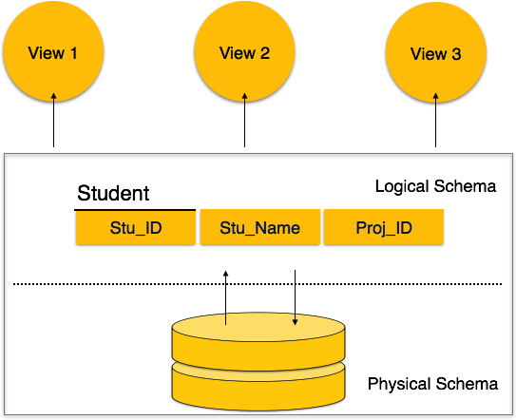

Slide 9
2. Logical Database Schema
The Logical database schema specifies all the logical constraints that need to be applied to the stored data.
It defines the views, integrity constraints, and table.
The logical schema represents how the data is stored in the form of tables and how the attributes of a table are linked together.
At this level, programmers and administrators work, and the implementation of the data structure is hidden at this level.
Various tools are used to create a logical database schema, and these tools demonstrate the relationships between the component of your data; this process is called ER modelling.

Slide 10
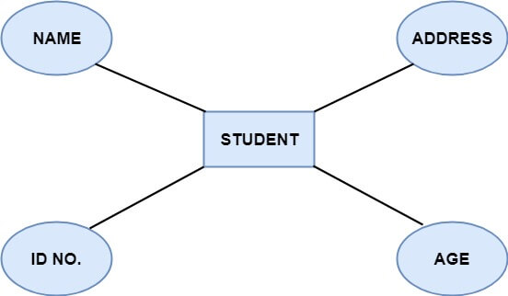
Continued…
The ER modelling stands for entity-relationship modelling, which specifies the relationships between different entities.

Slide 11
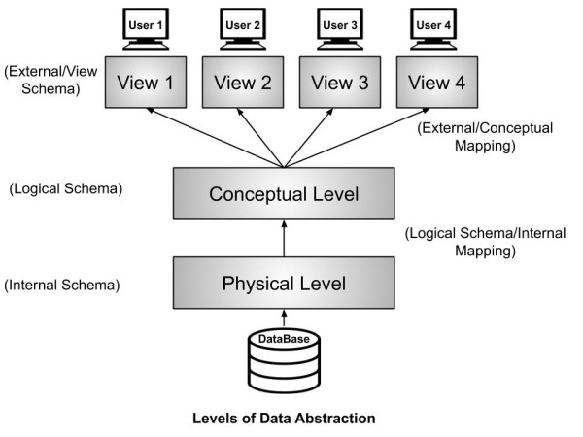
3. View Schema
The view level design of a database is known as view schema. This schema generally describes the end-user interaction with the database systems.

Slide 12
THANK YOU

